Slide 1
DATABASE EPOKA CLUBS
Team members:
Aldrin Çifliku
Brinaldo Vorfi
Erlis Këndezi
Fabiona Tafçiu
Juljan Losha

Slide 2

TABLE OF CONTENTS
01
02
03
04
Introduction
What is the database about?
Requirements gathering
Outline on the process of interviewing actors of interest and database design
ERD AND RS
Detailed explanation on the database logical and conceptual design
SQL VISUALIZATION
Pictures that show how the tables for certain queries look like

Slide 3
01
About the project

Slide 4
INTRODUCTION
Our project involves the development of a database about the clubs of Epoka University. Since Epoka does not have a current database, we had to create it from scratch. It should fulfill the requirements of our client (the Epoka Clubs’ President) and be functional.

Slide 5
PROJECT MANAGEMENT
ID | Tasks | Step 1 | Step 2 | Step 3 | Step 4 | Step 5
1 | Form the group
2 | Requirement gathering
3 | ERD AND RS designing
4 | SQL
5 | Documentation and presentation

Slide 6
02
Requirements Gathering

Slide 7
MAJOR REQUIREMENTS
Information of students
Information of clubs
Events
The information about events should not only be detailed and coherent but also tightly connected to the certificates that are issued
The database should enable the user to store information about students proficiently
Likewise the database must store all the information about clubs

Slide 8
Club specific requirements
Certificate award criteria
Some clubs offer certificates for each event, others after a number of events
Passwords of social networks
Such passwords should be stored to avoid changing them every year and to give access to new managers

Slide 9
Conceptual and logical design
03

Slide 10
PROJECT GOALS
Goal 4
Goal 1
Goal 2
Goal 3
Easier to connect database
Avoid redundant data
Fix the issues with the event's attendance
Make the database consistent and adaptable to changes

Slide 11
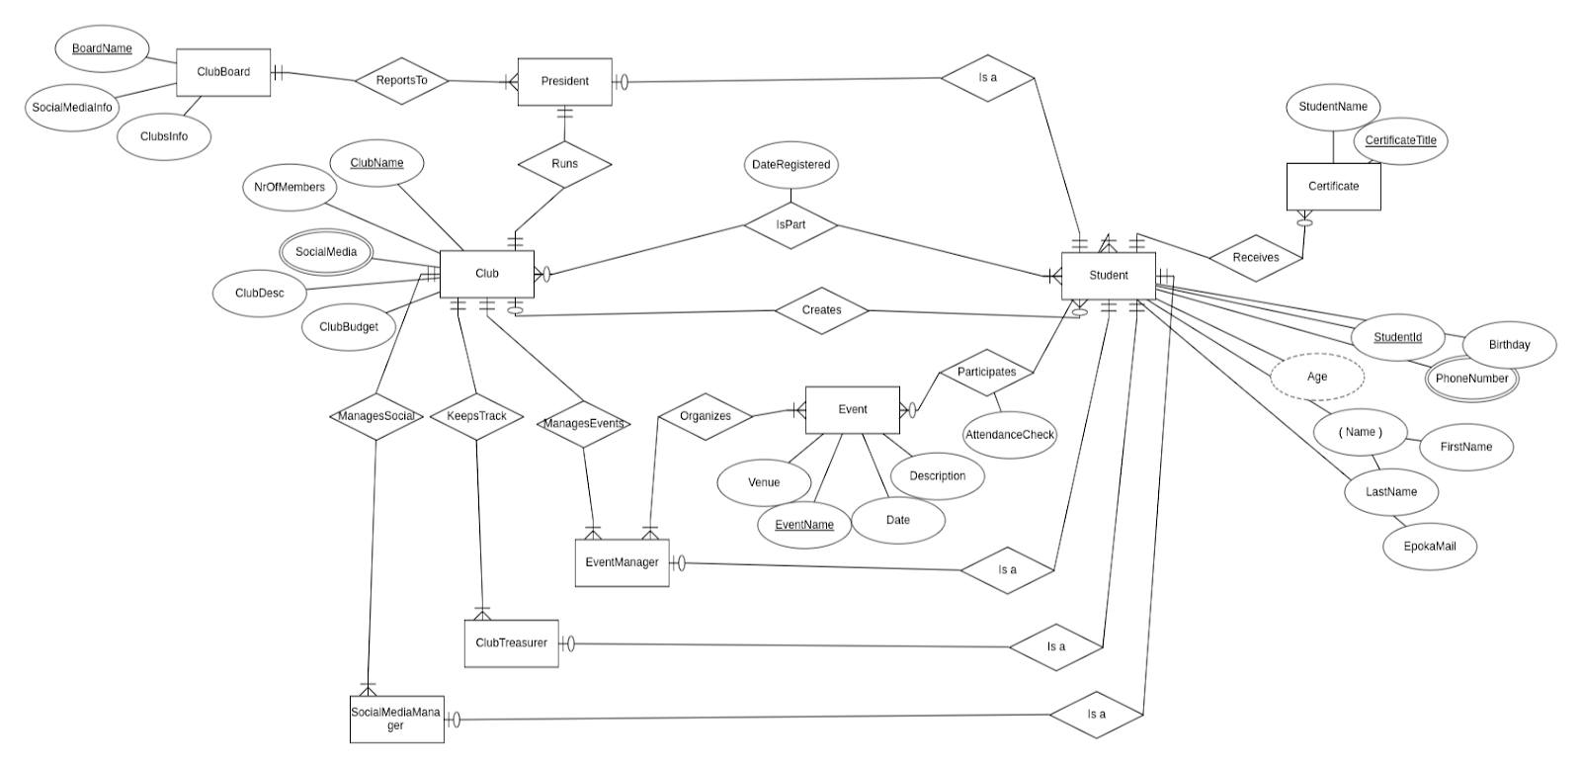
ERD

Slide 12
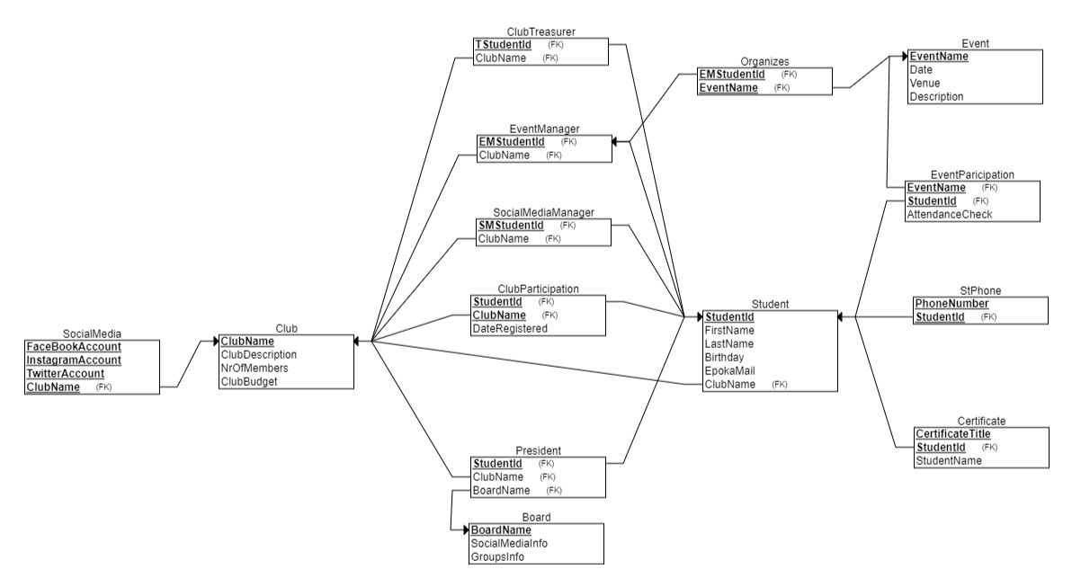
RS

Slide 13
Managerial Queries

Slide 14
Here we are going to show you some managerial queries that retrieve data from one or more tables.

Slide 15
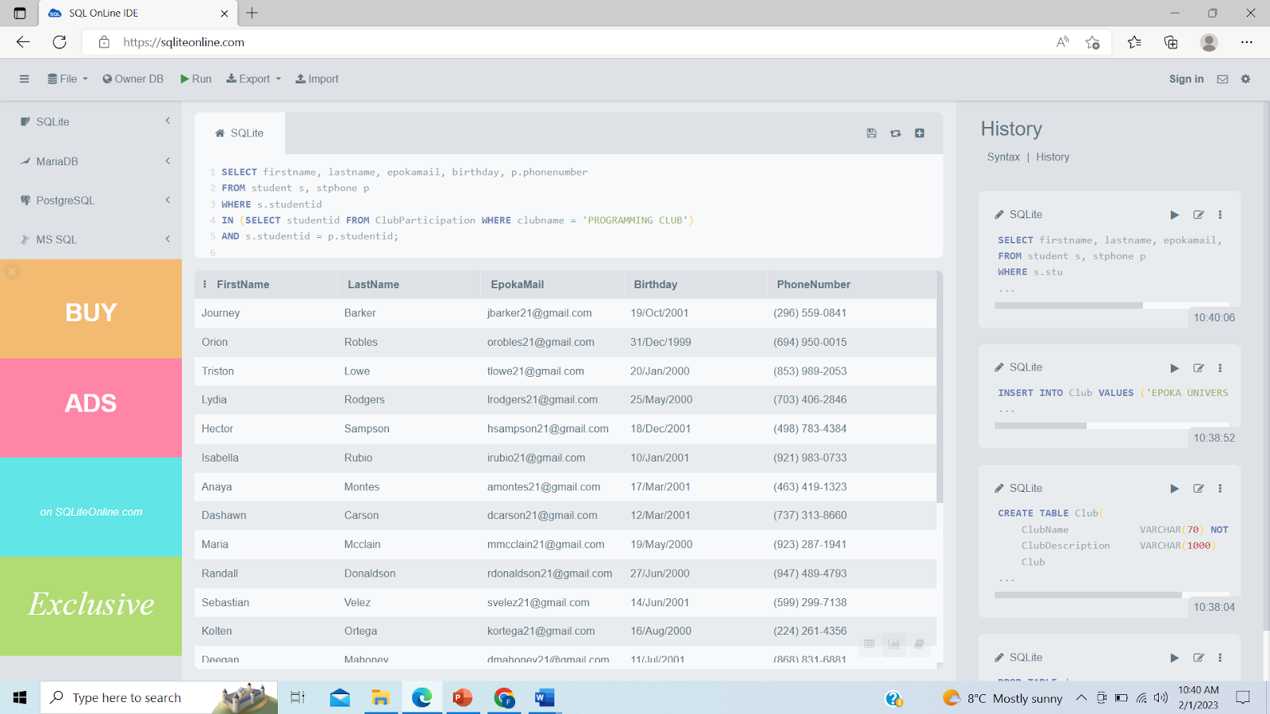
Managerial queries
Show the information of all students from a specific club

Slide 16
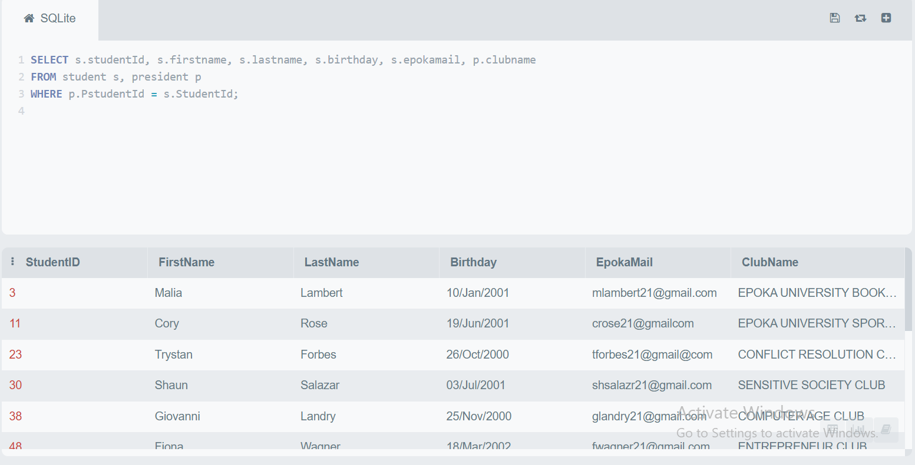
Managerial queries
Get all info for each club’s president

Slide 17
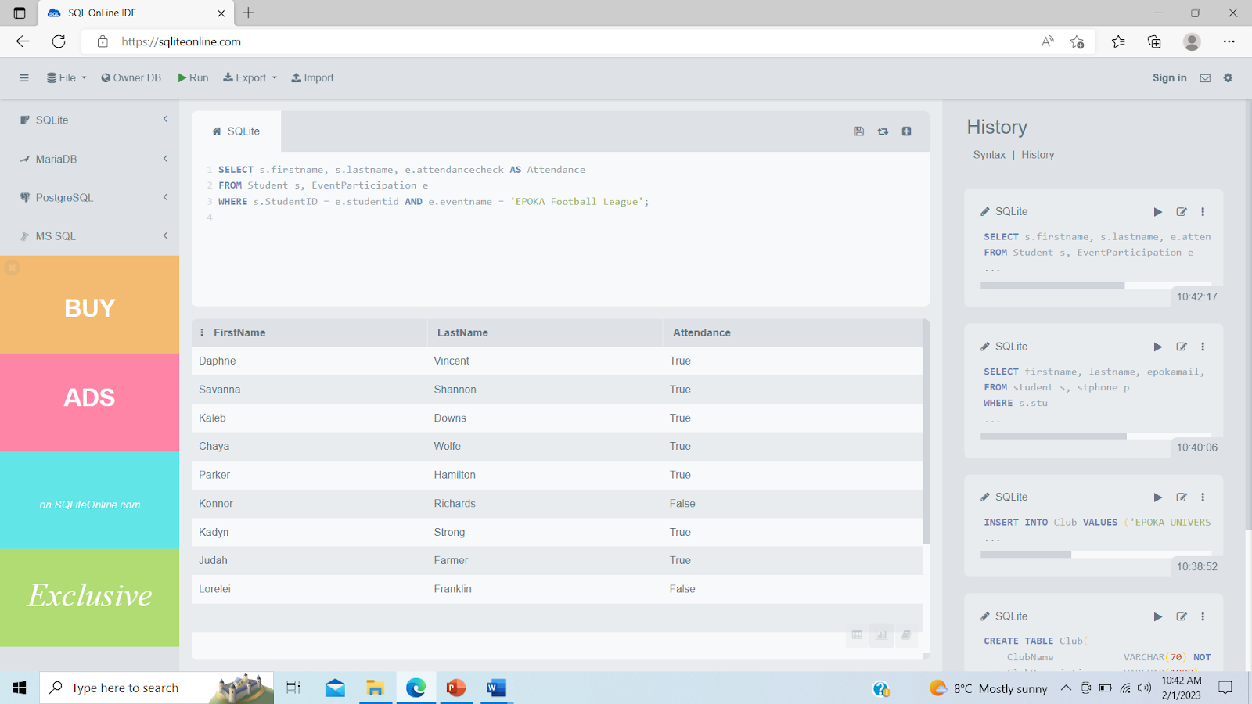
Managerial queries
Show the attendance list for a specific event

Slide 18
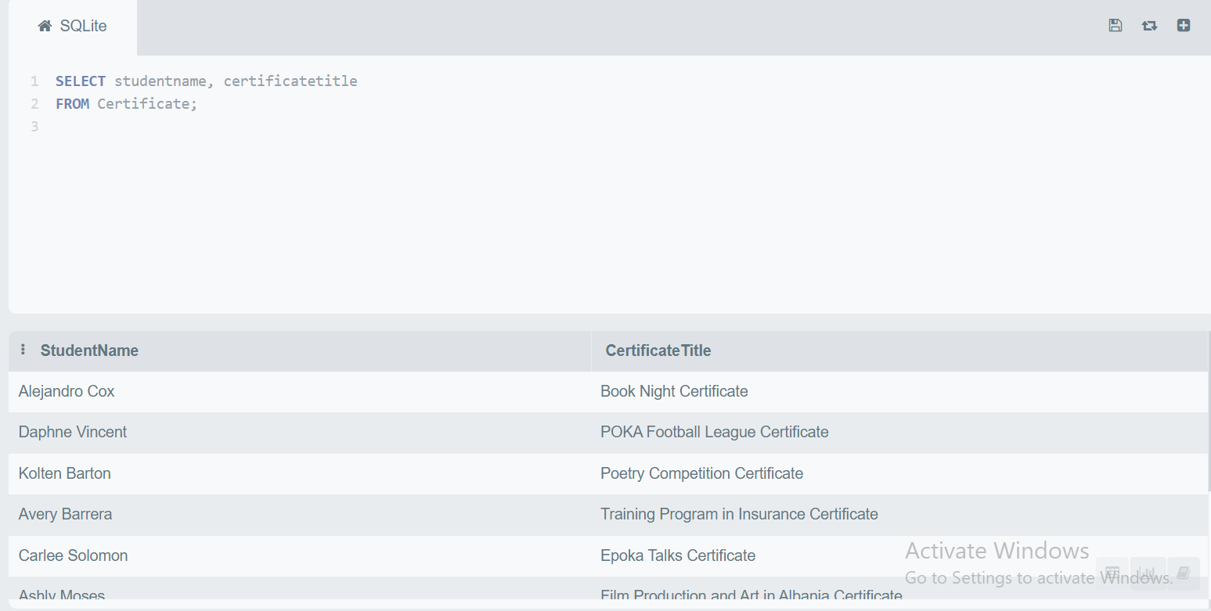
Managerial queries
Show the names and the certificate awarded for all students that
earned a certificate

Slide 19
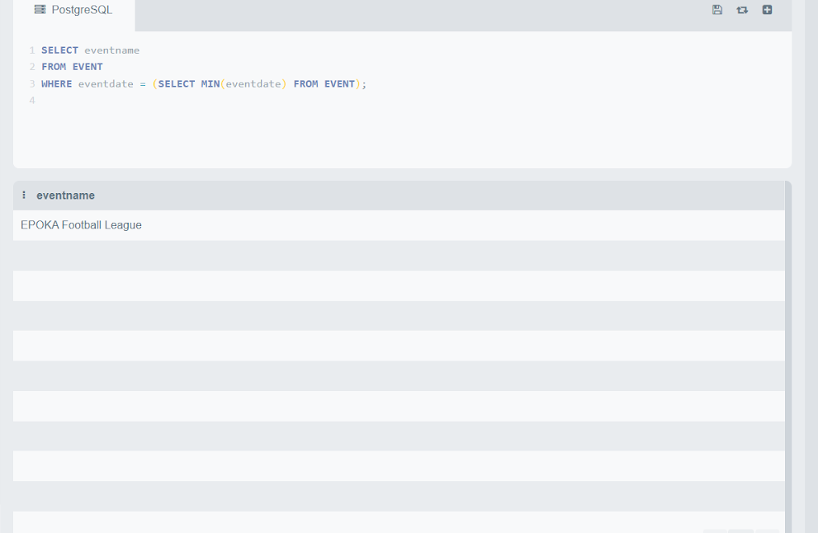
Managerial queries
Show the name of the earliest event

Slide 20
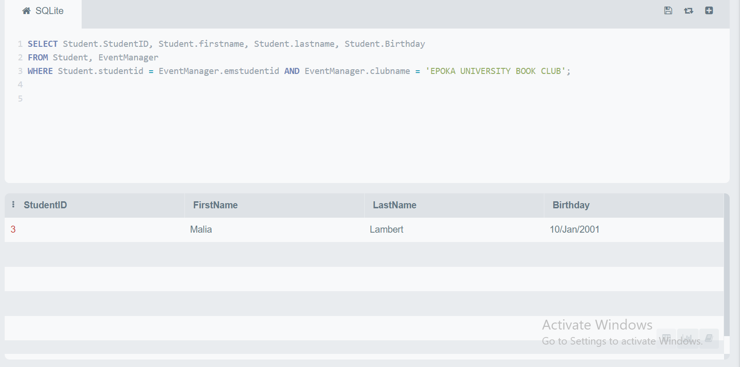
Managerial queries
Find the information for the event managers given the club's name

Slide 21
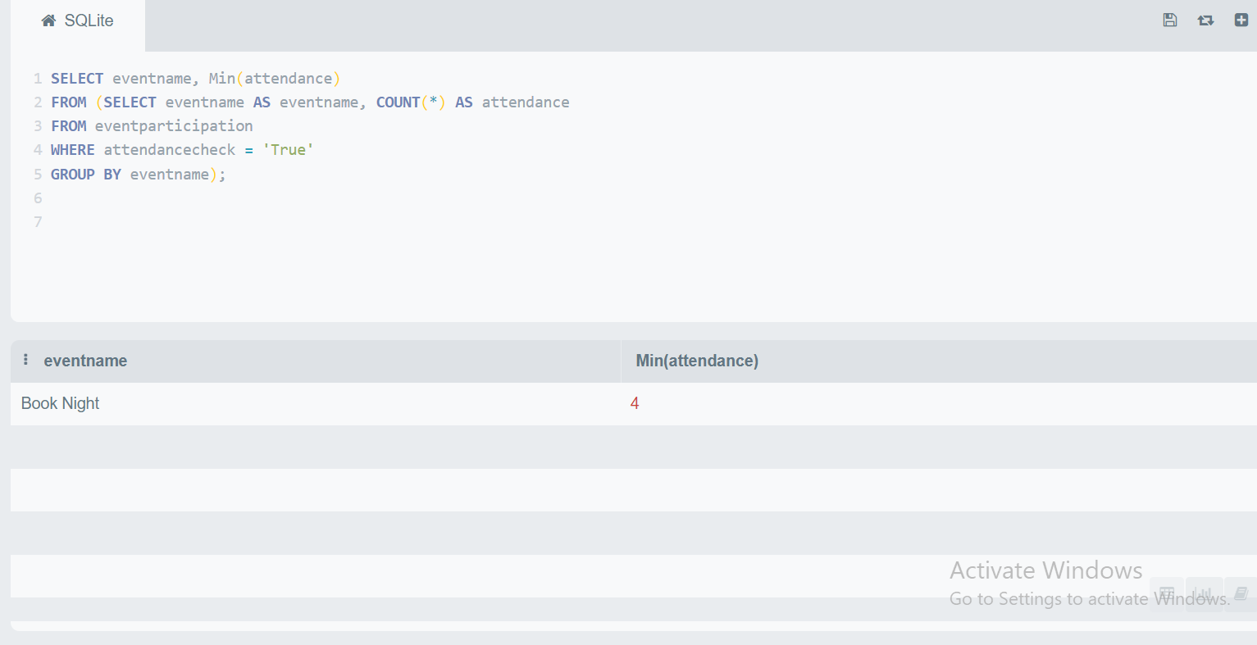
Managerial queries
Show the name of the least attended event

Slide 22
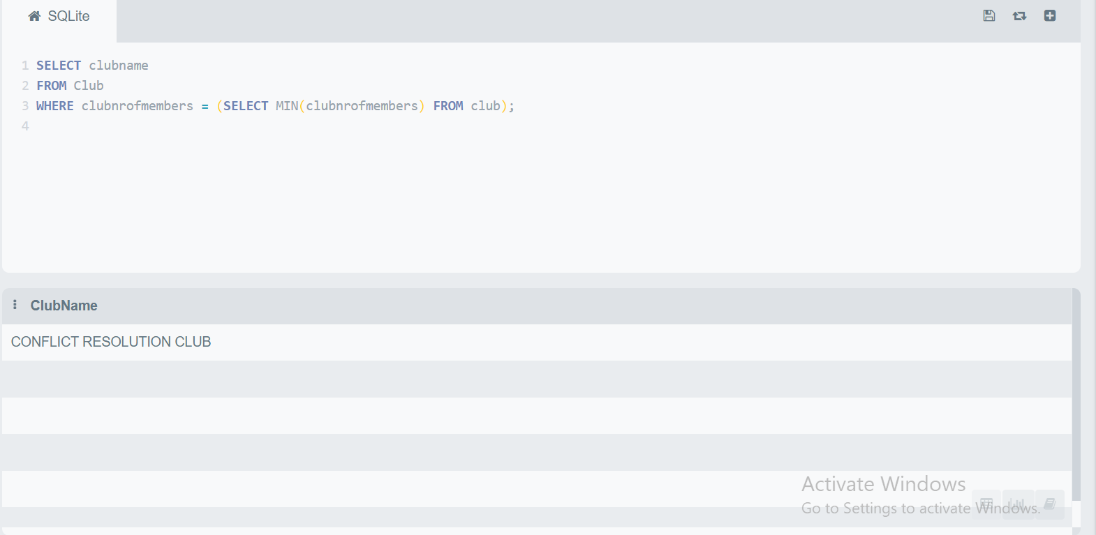
Managerial queries
Show the name of the club with the least nr of members

Slide 23
Any question?
THANK YOU

